Slide 1

NBA dataset analysis
Guillermo Contreras

Slide 2

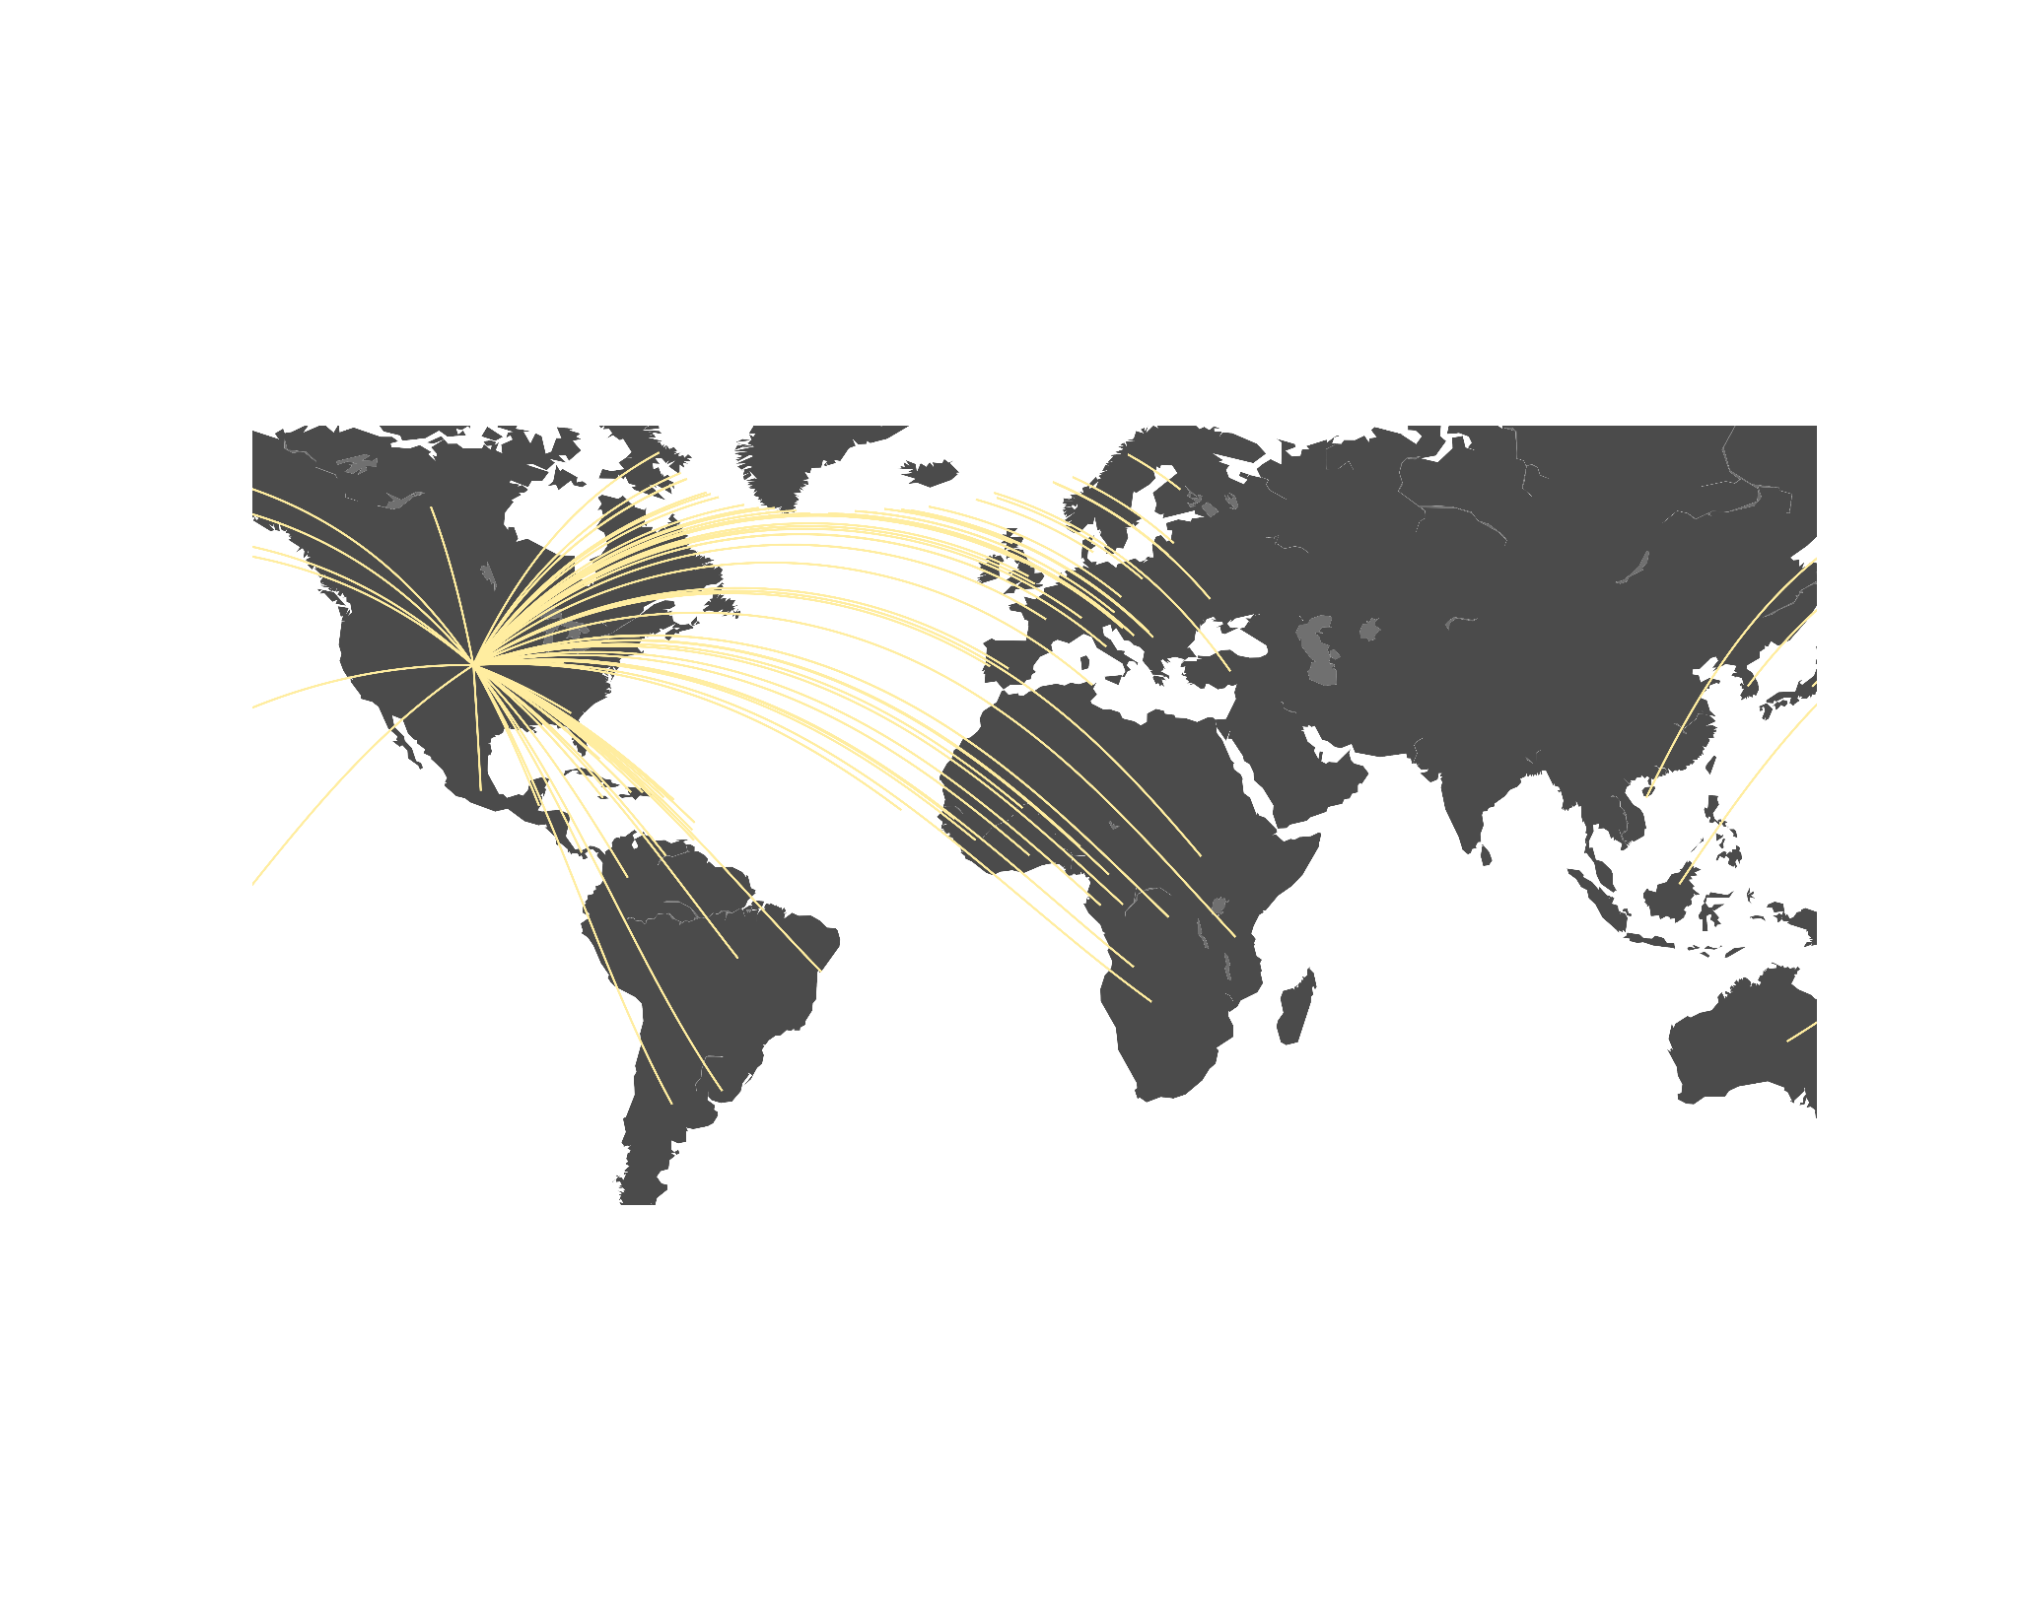
Most common player’s origin countries
82 COUNTRIES

Slide 3

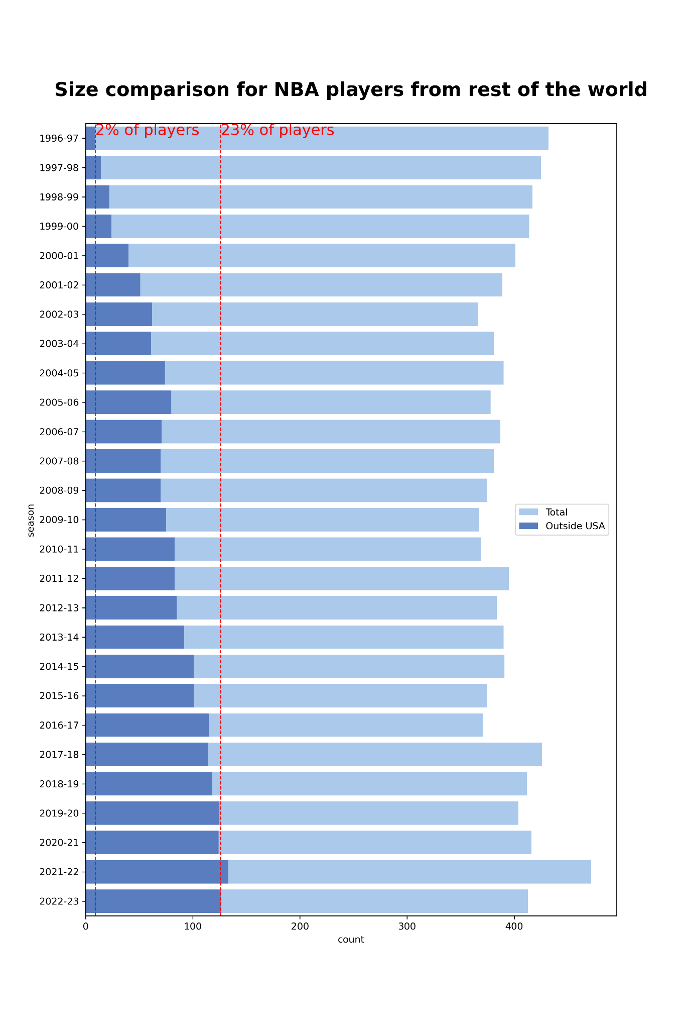
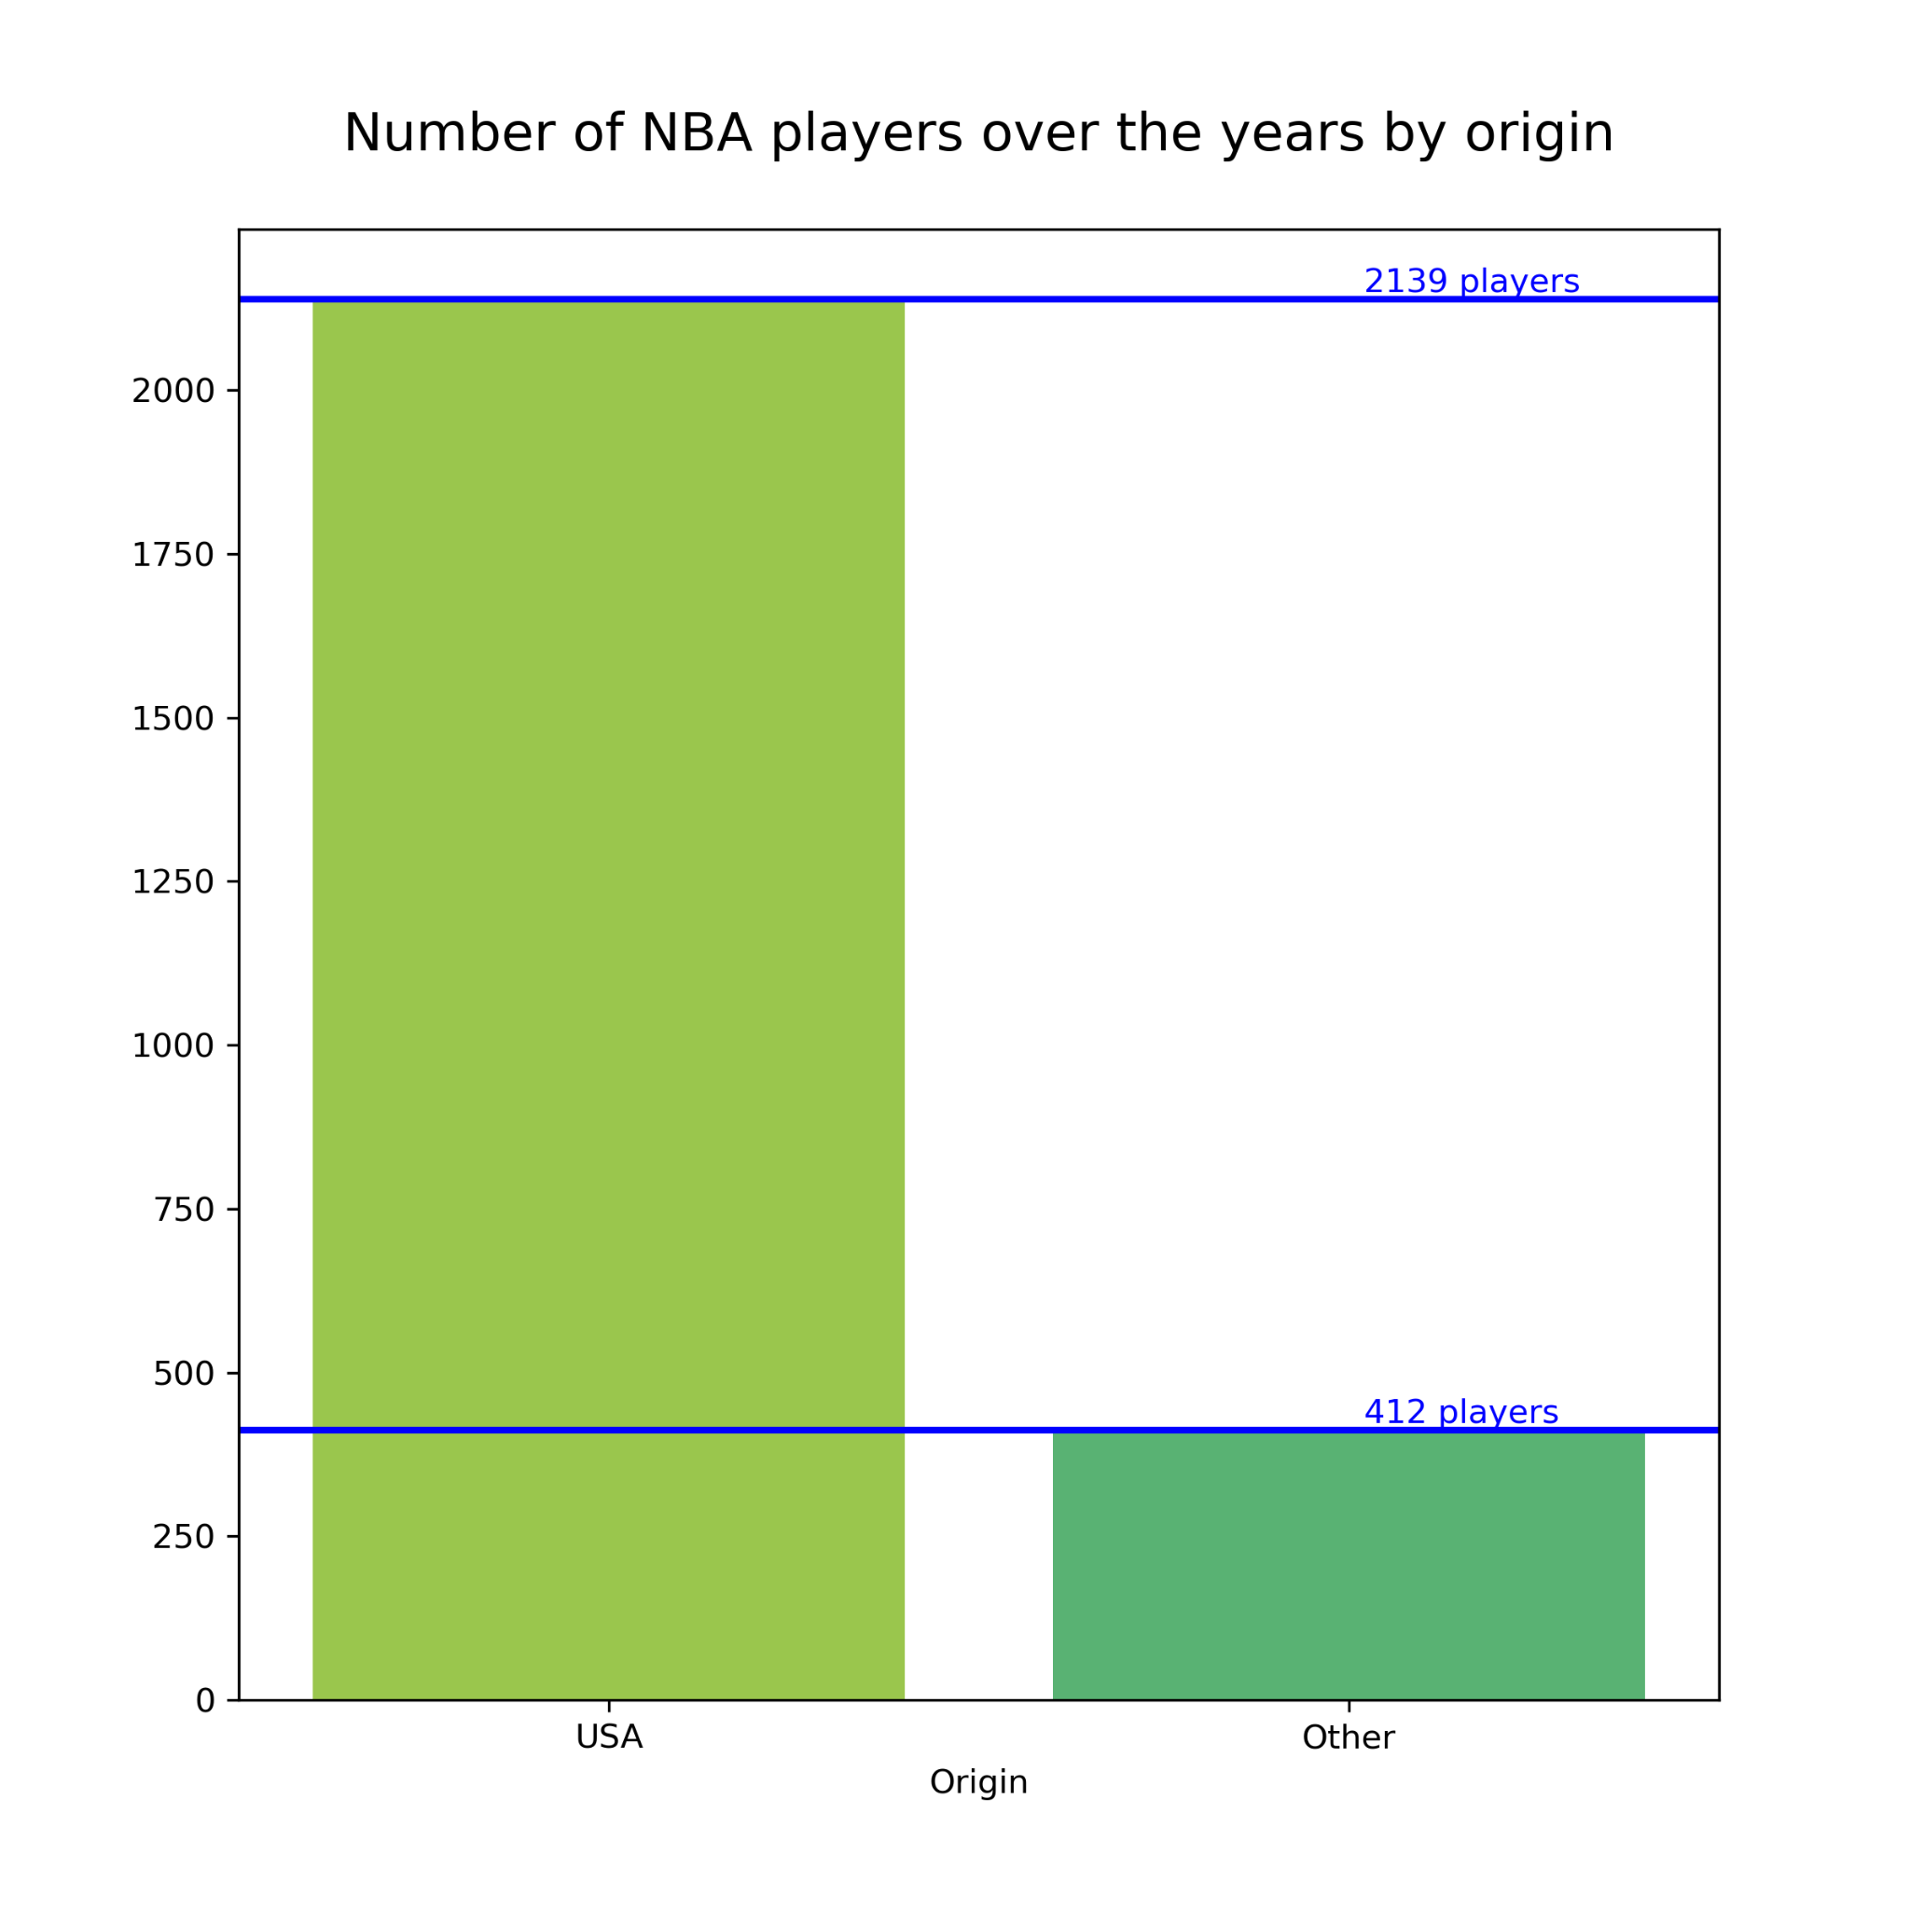

Slide 4

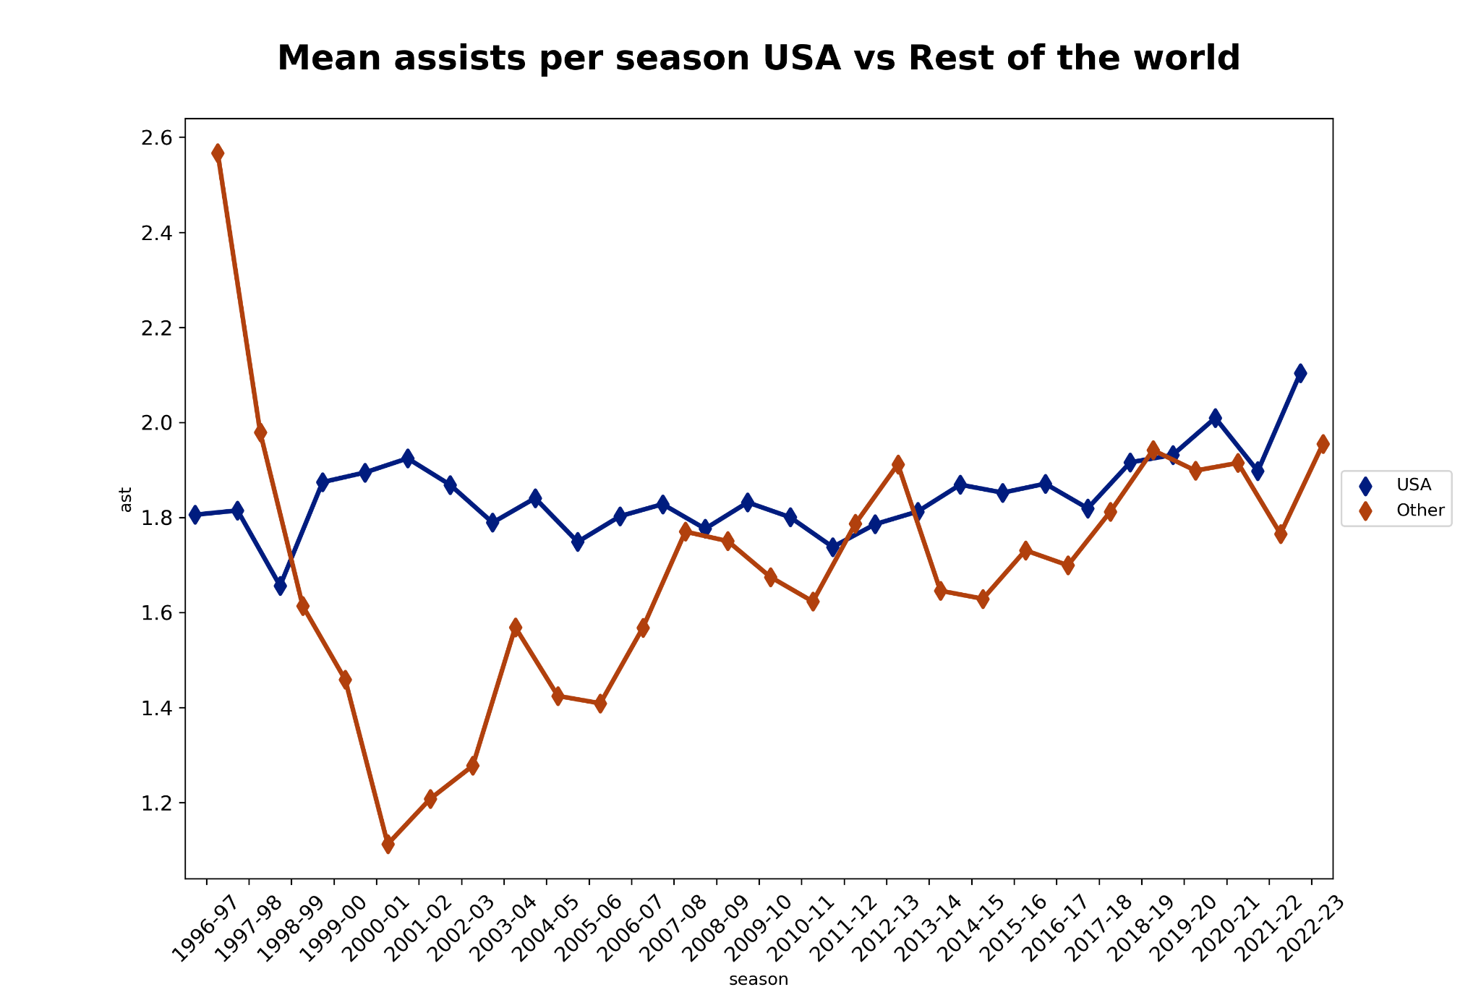
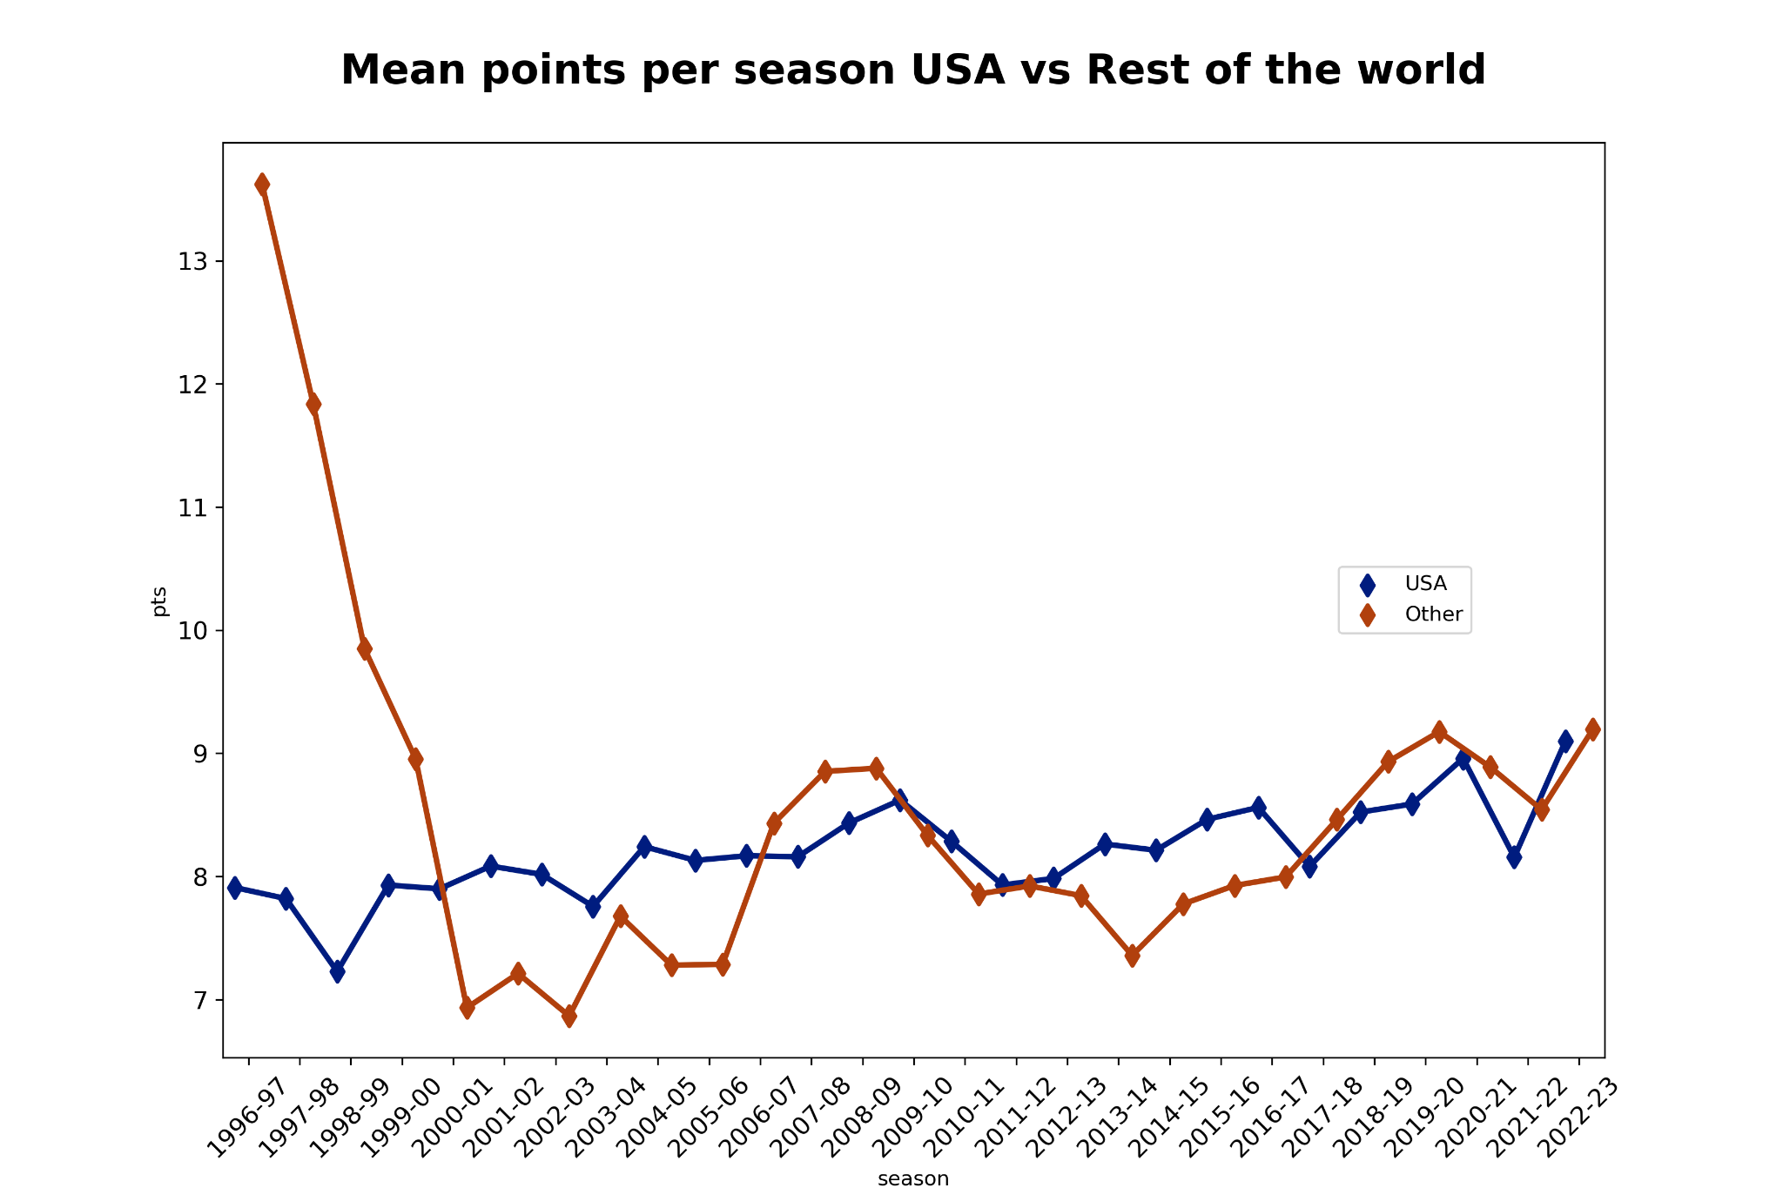
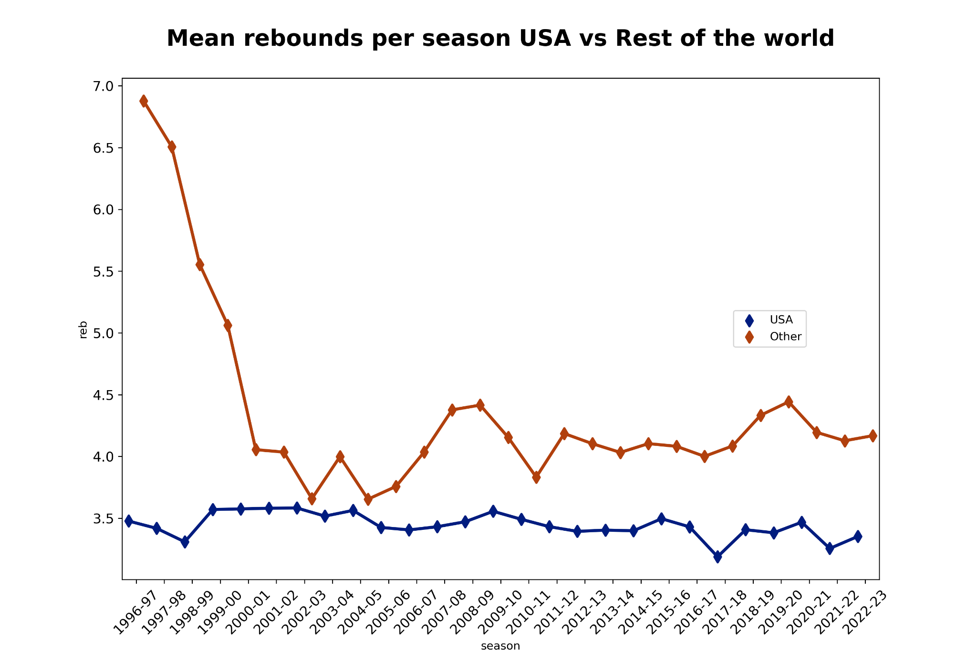

Slide 5

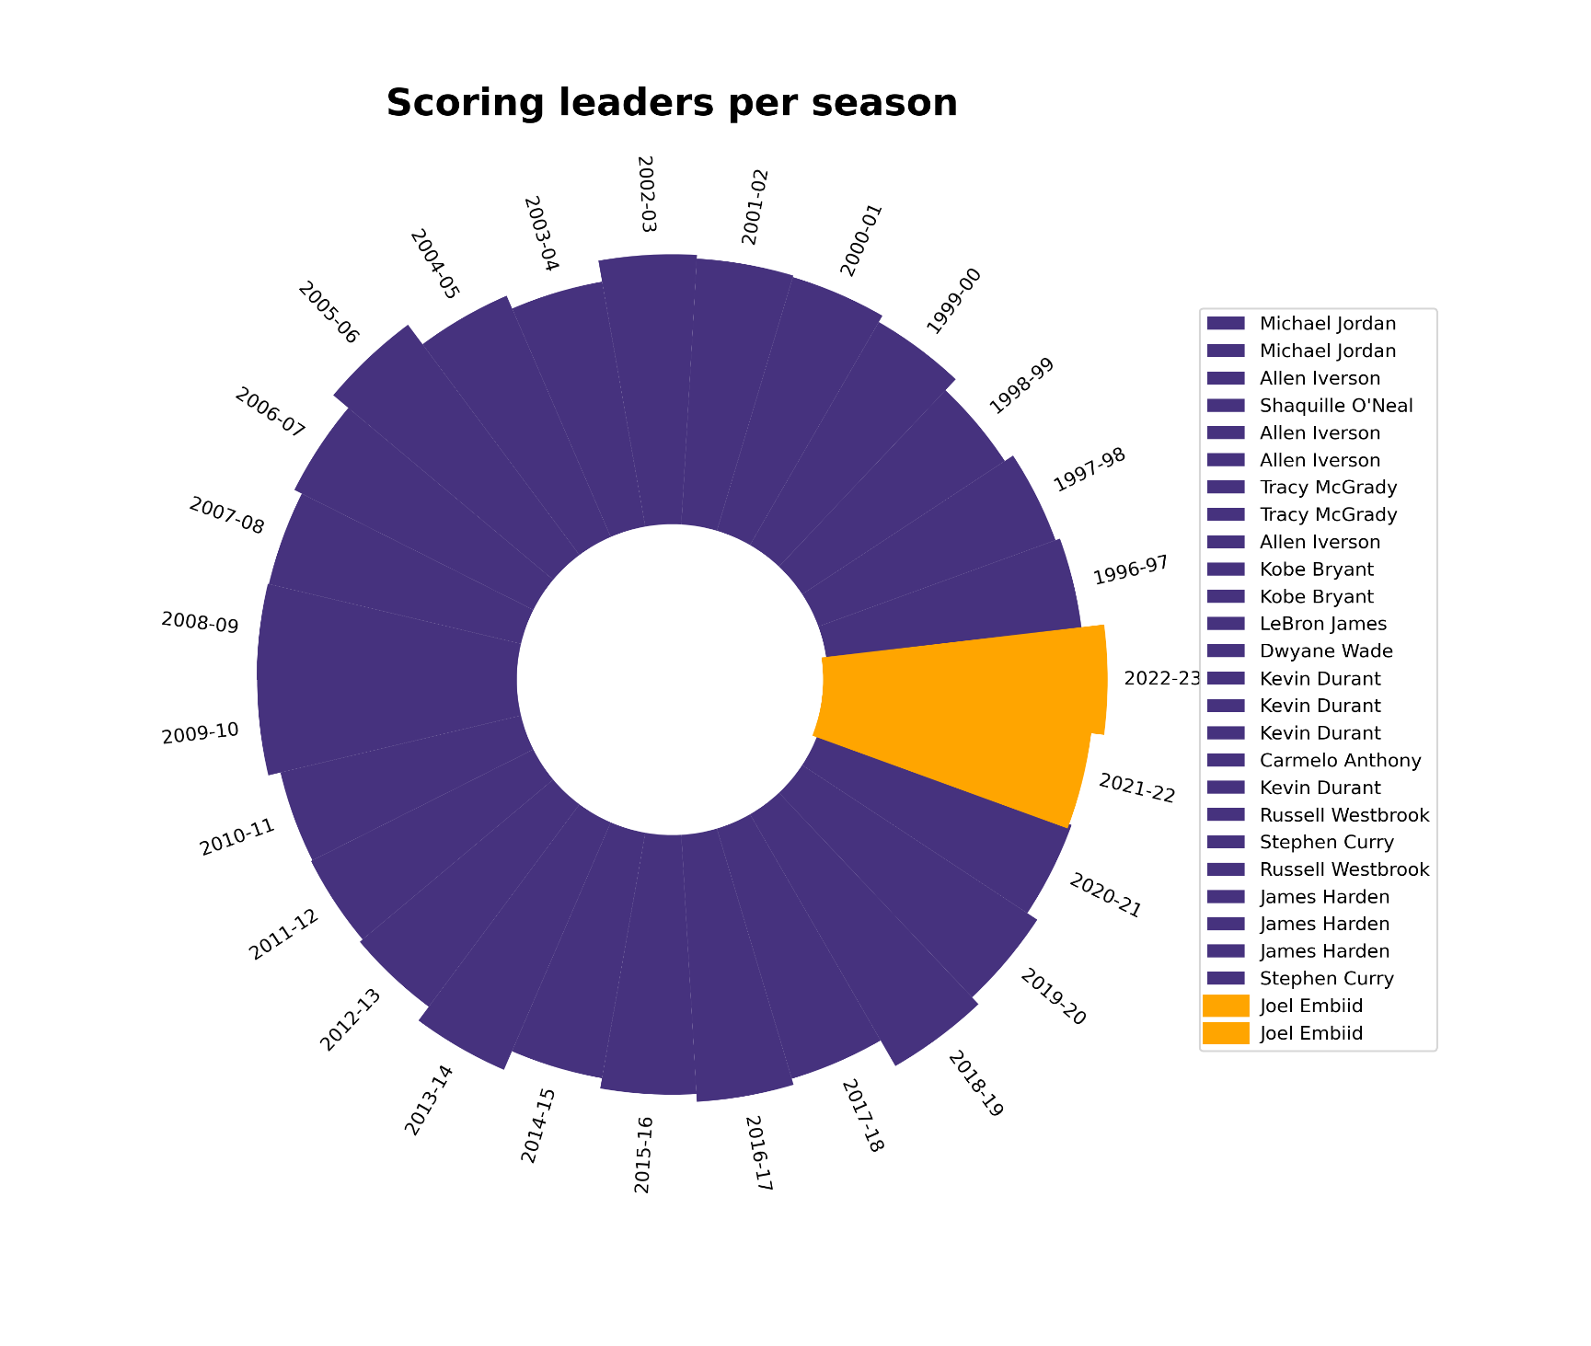

Slide 6
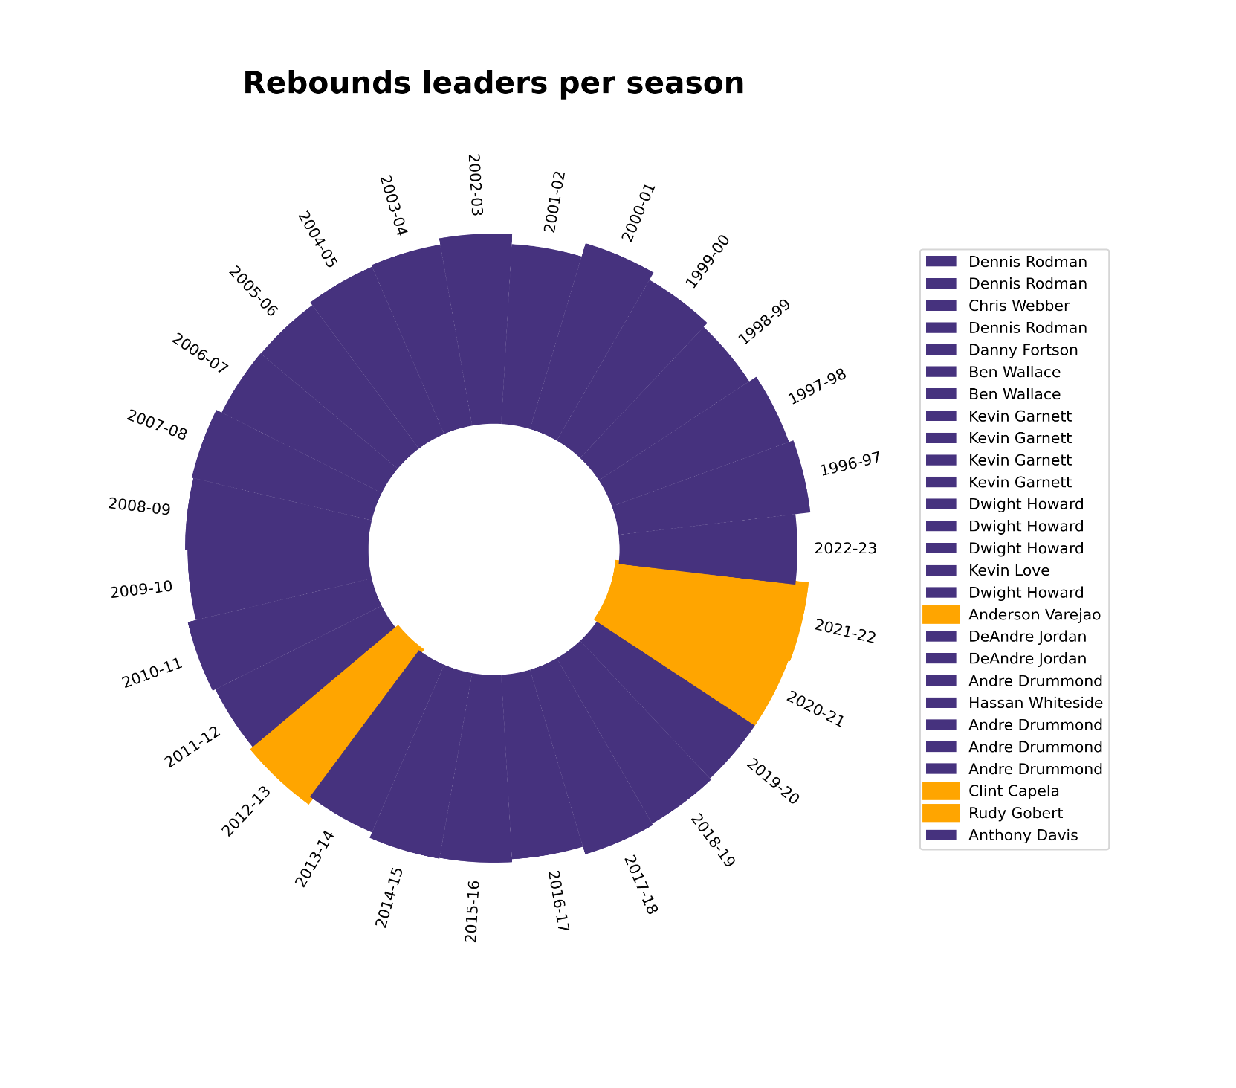

Slide 7
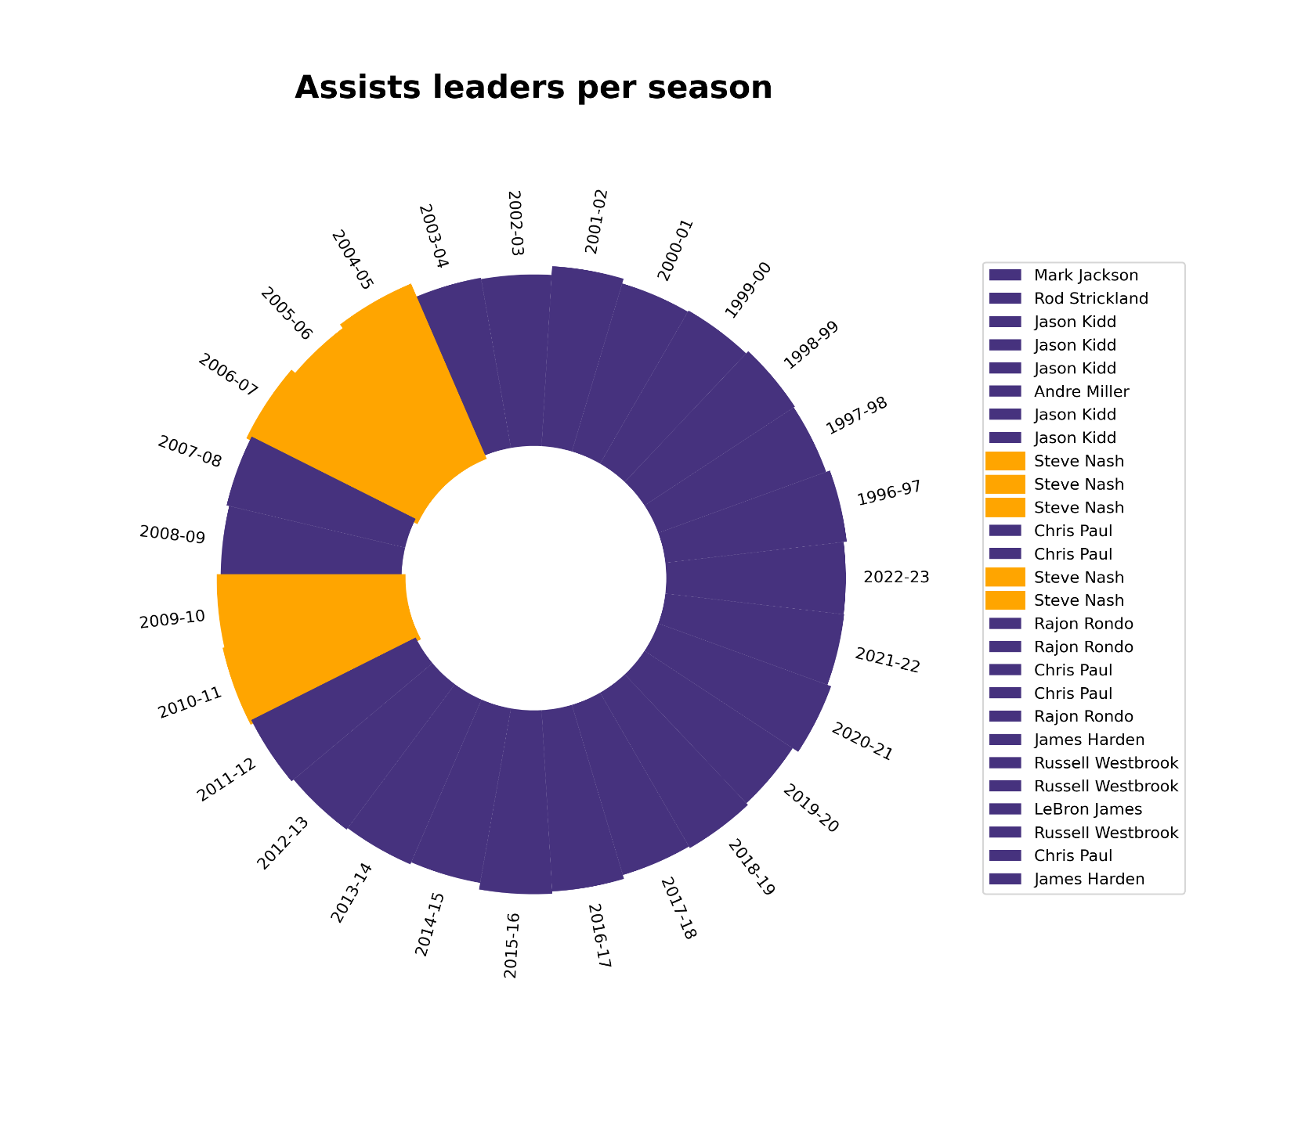

Slide 8

Can we compare the trajectory of a player with its rank in the draft?
We can set quantiles for the average pts, reb, and ast of all players during the years.
Set q_pts = 0.99
Set q_ast = 0.95
Set q_reb = 0.95
Are there non-USA players that fulfill this 3 conditions?

Slide 9

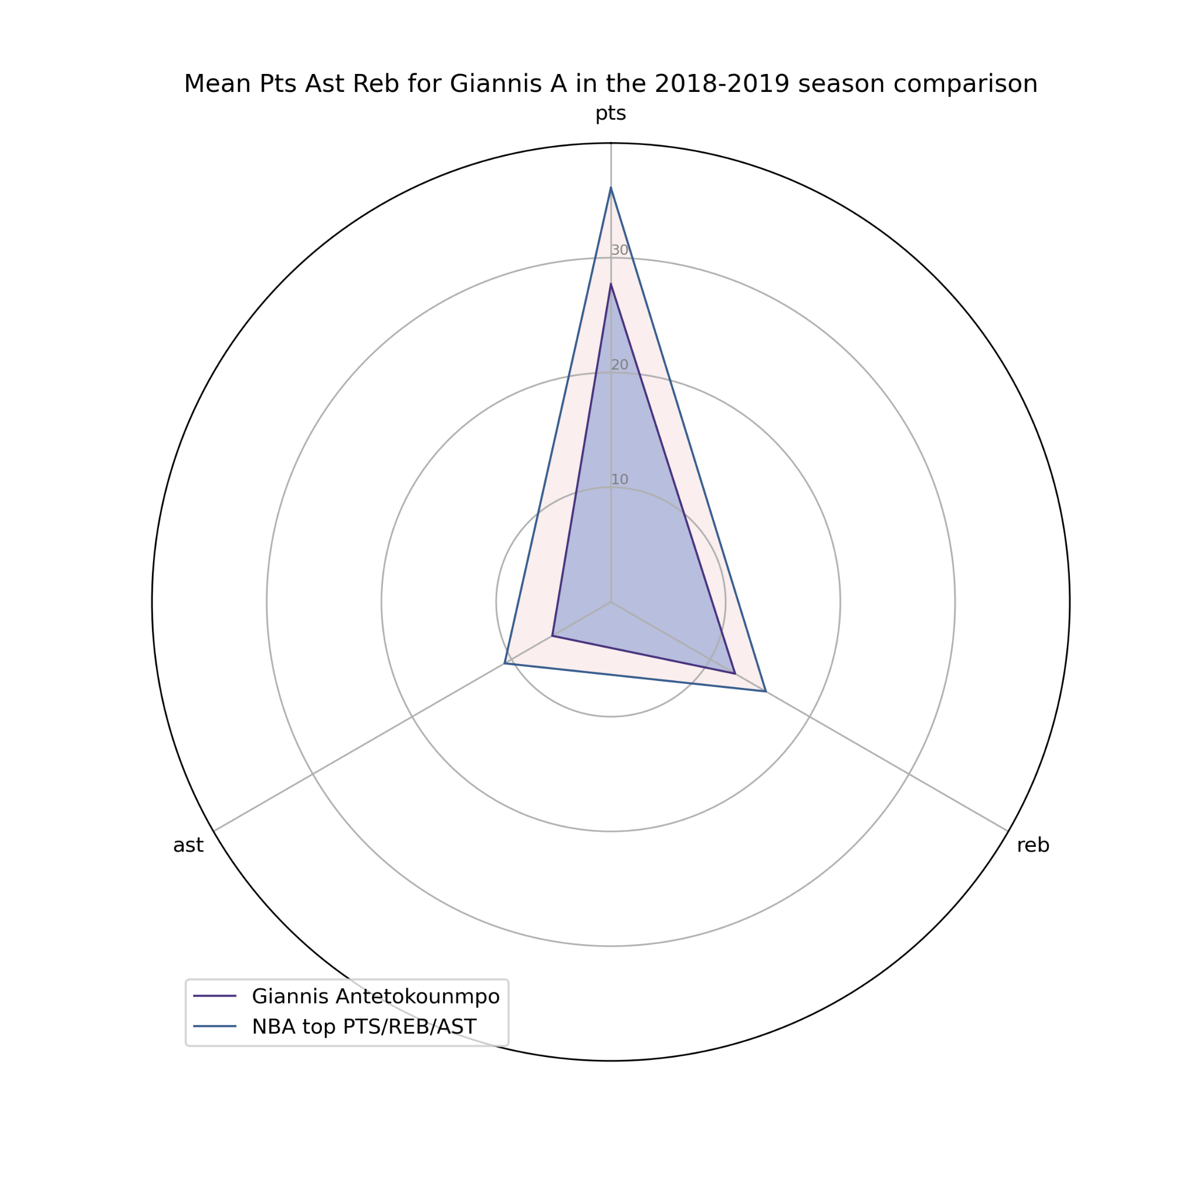
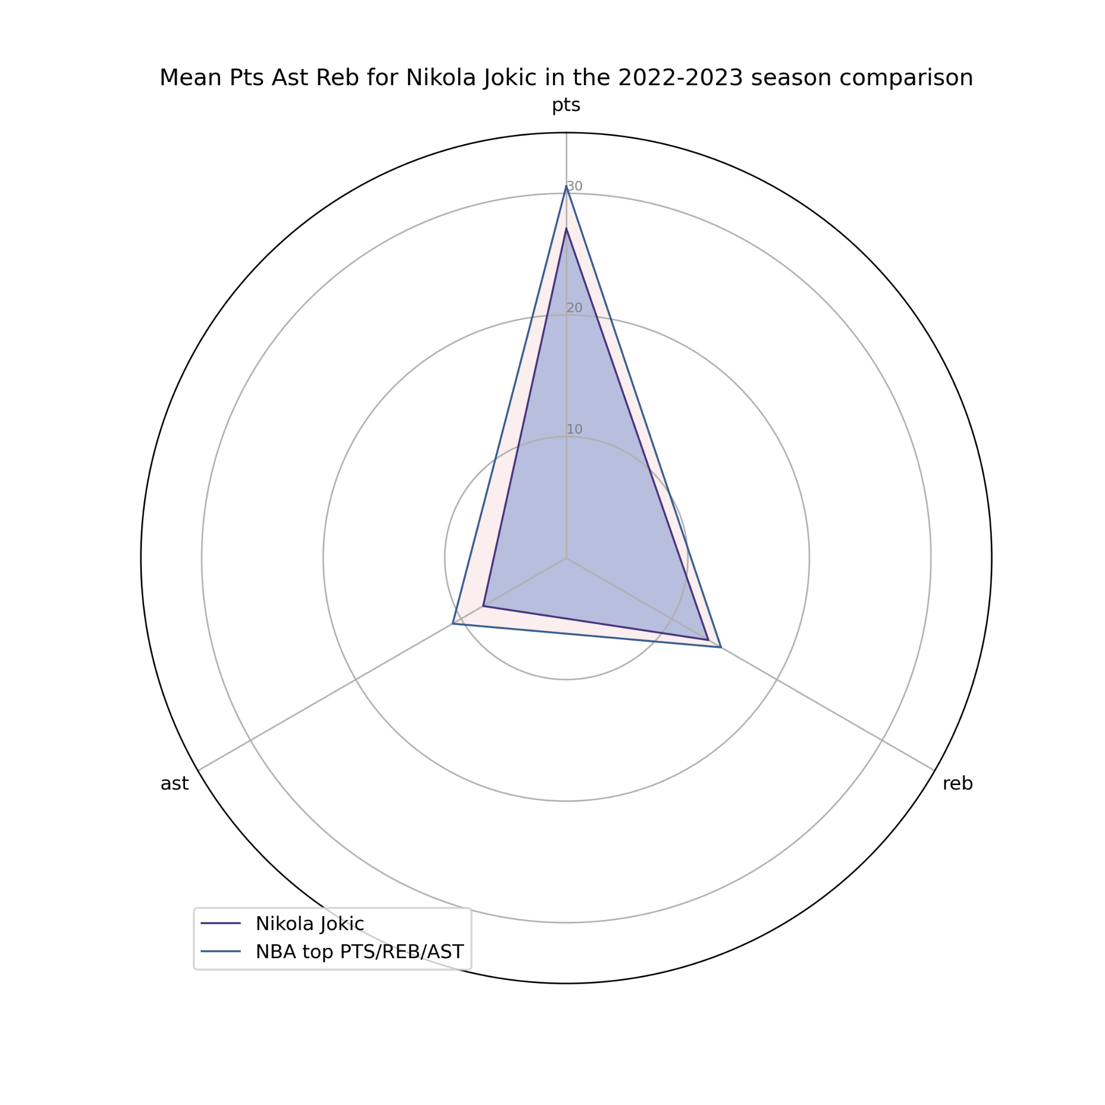
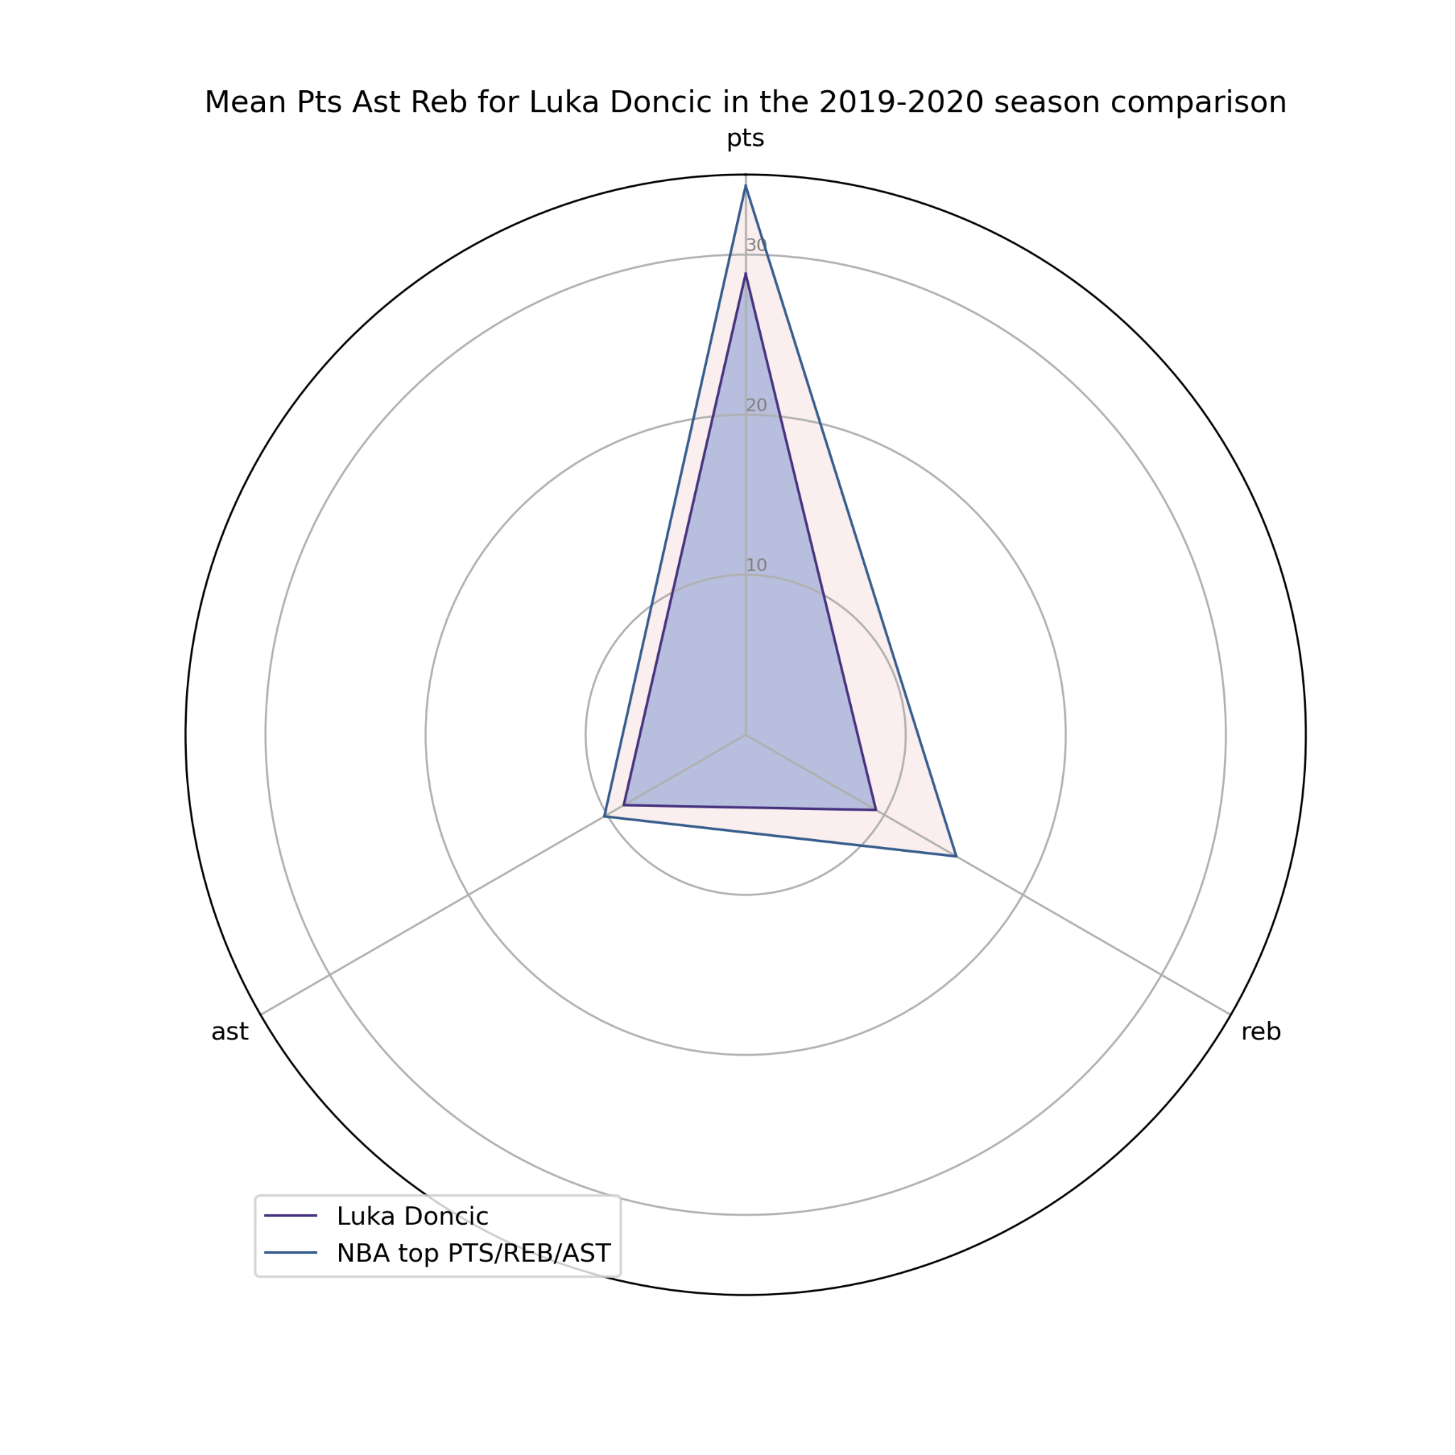
OVERLOOKED PLAYERS?

Slide 10
Can we visualise this?
How often does this happen?
Does it matter if the player is from outside USA?
We determine a threshold Q
Q = a * q_ast + b *q_points+ c * q_reb
Each player gets its own q_score, the sum of their mean pts, ast, reb
A draft number above 10 for a player that performs better than Q is considered an overlook

Slide 11

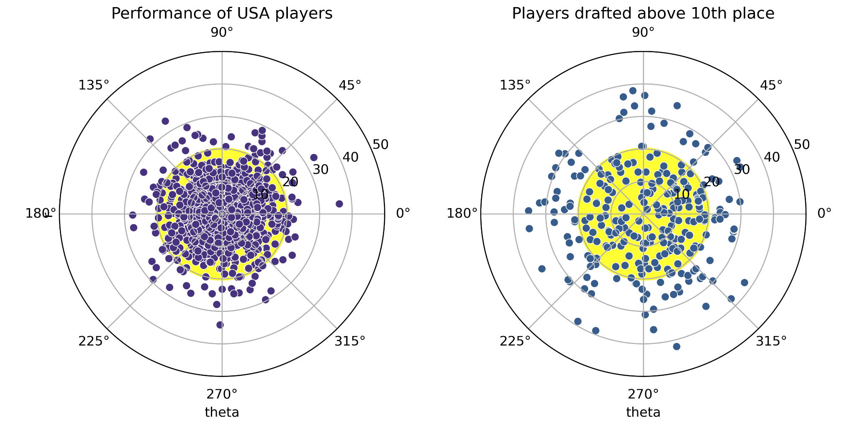
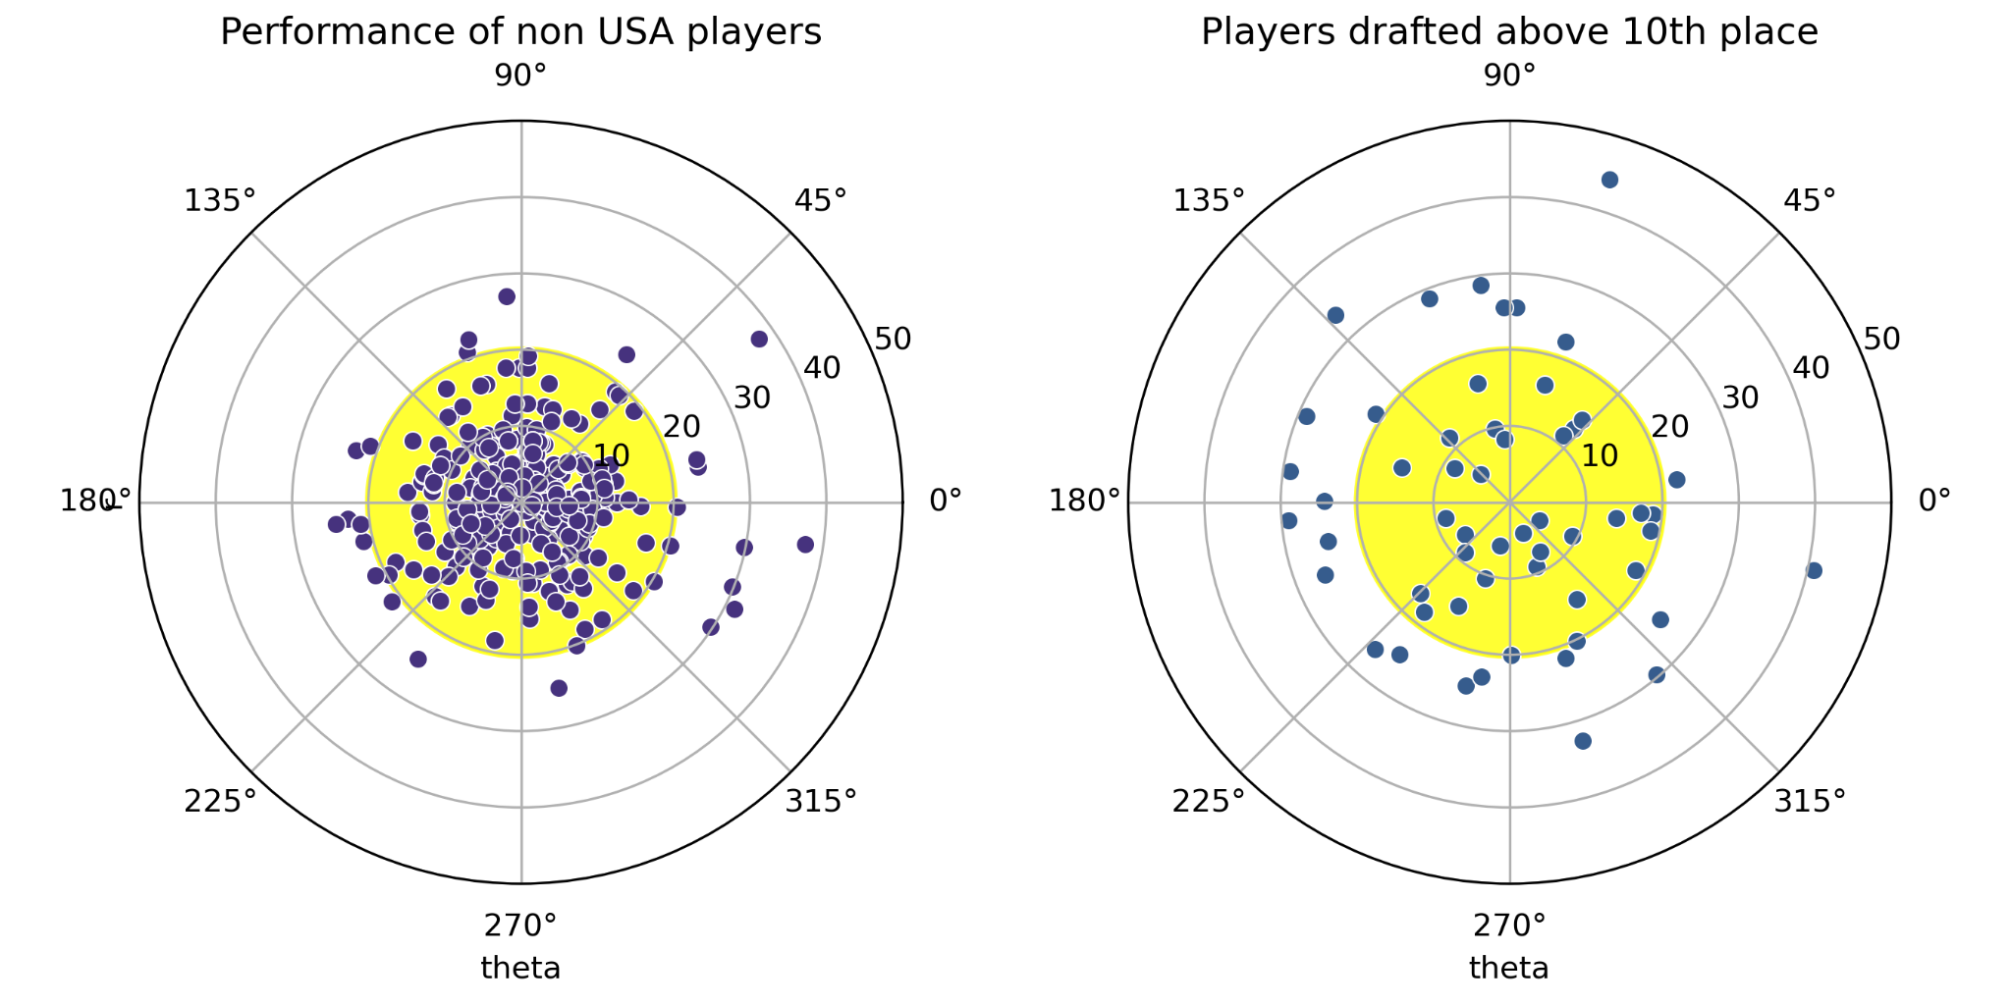
Are non USA players underrated?
4%
6%

Slide 12
THANK YOU!

